Slide 1
Automatic Test Generation and Logic Optimization

Slide 2
Types of Errors in a Digital System
Software error : detected by design validation
  Design (conceptual) faults
  Implementation faults
Hardware error : detected by testing
  Physical faults

Slide 3
Testing of Hardware Error
DL = 1-Y ^{(1-T)}
  DL : Defect level
  Y : Yield
  T : Test coverage
Methods of testing
  Functional testing
  Structural testing

Slide 4
Faults and Fault Models
Fault
  shorts, defective soldering, …
Fault model
  stuck-at fault
  bridging fault
  stuck-open fault
Single stuck-at-0/1 fault
  computationally efficient
  represents most of defects which occur in real logic devices
  detects many faults of other types

Slide 5
Single Stuck-at Fault
Single gate terminal stuck at either 0 or 1
Faults on the stem, and branches
The total number of faults is 2N, where N is the number of gate terminals
= fault site

Slide 6
Equivalent Faults
Let F₁ and F₂ be the functions performed by C in the presence of f₁ and f₂, respectively. Then faults f₁ and f₂ are equivalent if and only if F₁ = F₂
Fault collapsing
Generate only one test for a group of equivalent faults
s-a-0
s-a-0
s-a-0
s-a-0 s-a-0 s-a-1 s-a-1

Slide 7
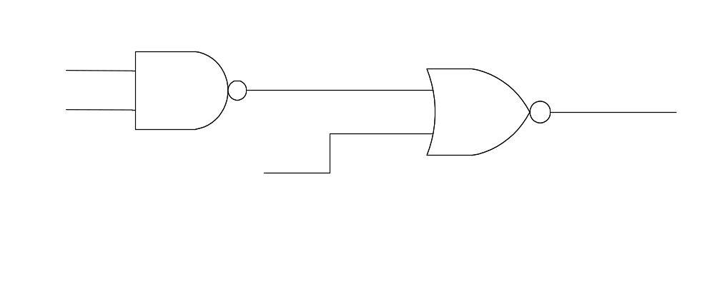
Testing of a Circuit
a
d
e
b
G1
G2
s-a-1
c
b = 0 c = 0 a = 1

Slide 8
Controlling and Non-controlling Value
Controlling value : when it present on at least one input of a gate, it forces the output to a known value
  AND gate, NAND gate : 0
  OR gate, NOR gate : 1
Non-controlling value : the complement of (Sensitizing value) the controlling value
  AND gate, NAND gate : 1
  OR gate, NOR gate : 0

Slide 9
Automatic Test Generation
Three steps
  Set up (fault sensitizing)
  Propagation (path sensitizing)
  Justification (consistency check)

Slide 10
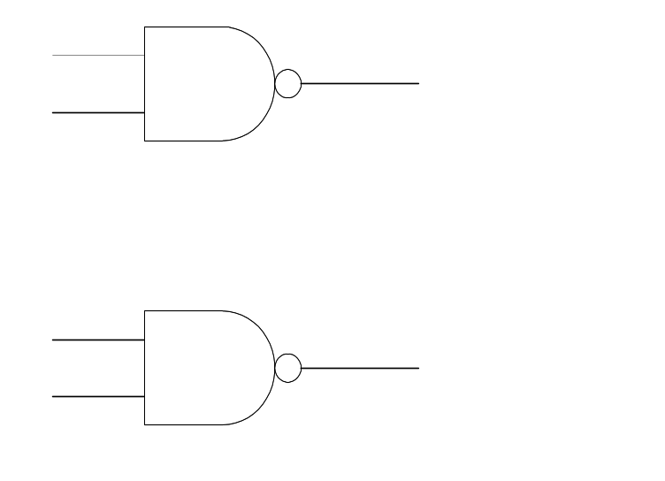
Test Generation (D-Algorithm)
The setup step is to produce a difference in the output signal at the gate where the fault is located between the two cases when the fault is present or it is absent
   D is called frontier
stuck-at 1
H
s-a-1
0
H
1
D
0 when fault occurs
D =
1 no fault

Slide 11
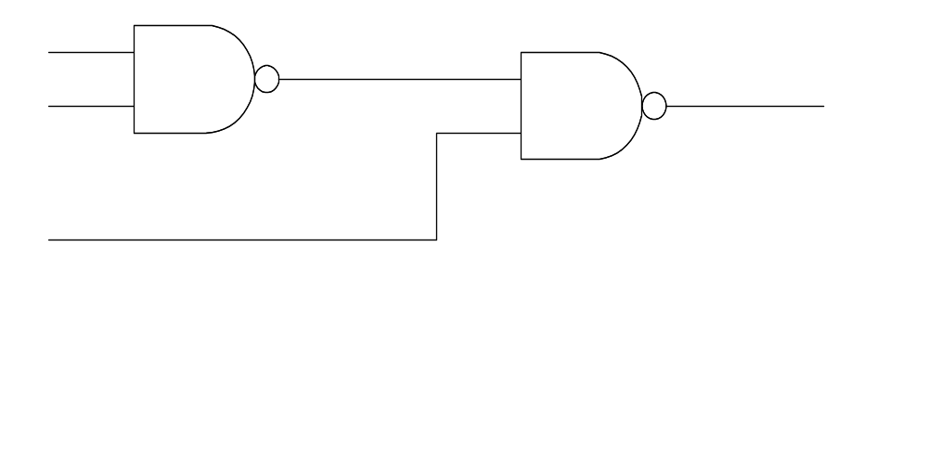
Test Generation (D-Algorithm)
The propagation step derives the D (or D) condition from the faulty gate to a output
stuck-at 1
0
H
D
1
J
D
1

Slide 12
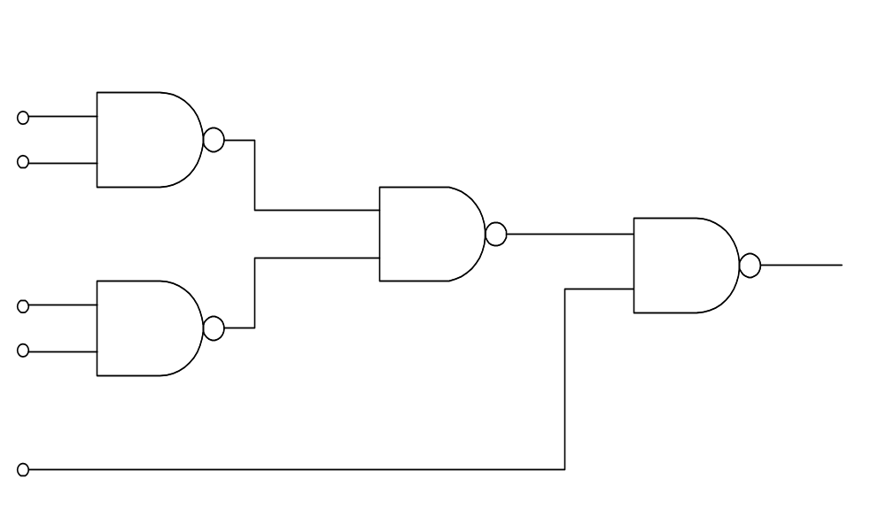
Test Generation (D-Algorithm)
The last step is to force the logic values needed to sensitize the assumed fault from the primary inputs
A
1
0
s-a-1
B
1
F
H
J
C
0
D
D
X
G
1
E
1

Slide 13
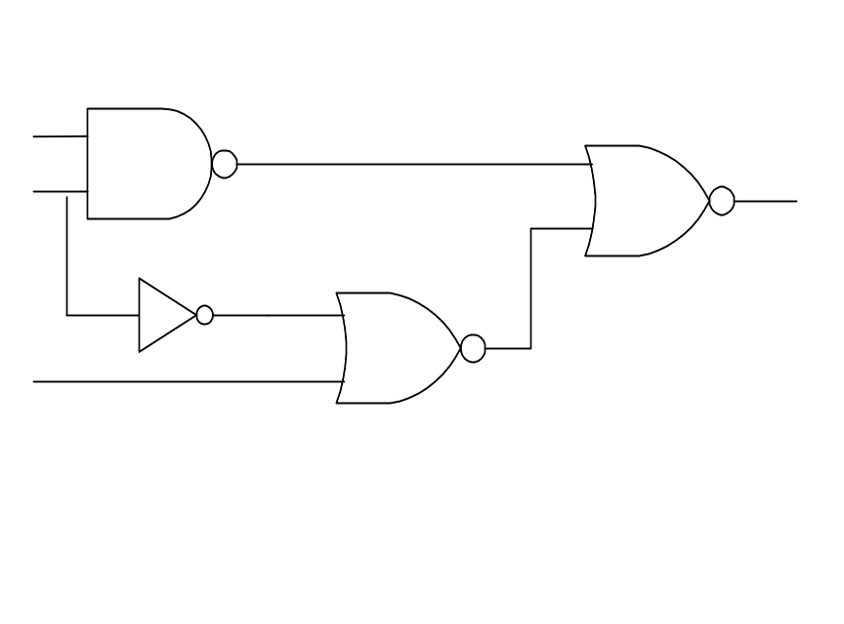
Backtracking
a
s-a-1
G1
e
g
b
G4
d
f
G2
G3
c
  1. excitation condition a = b = 1
  2. sensitization condition f = 0
  3. choose d = 1 ⇒ b = 0 (conflict)
  try c = 1 (succeed)
Backtracking : returning on one’s step and reversing a previous choice

Slide 14
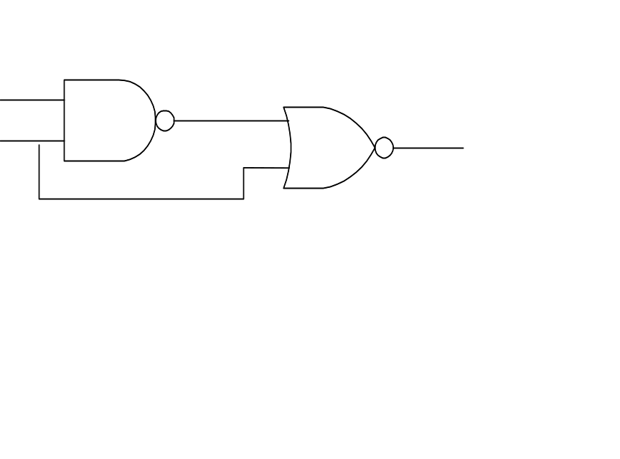
Untestable Fault
a
c
b
G1
G2
d
s-a-1
  1. excitation condition b = 0
  2. sensitization condition c = 0
  3. justification a =1 and b = 1 (conflict)
There is no test for b s-a-1 fault
b is redundant
Replacing b by 1 ⇒ d = 0
The conflicting requirement derived from reconvergent fanout (paths have a common source and a common sink)

Slide 15
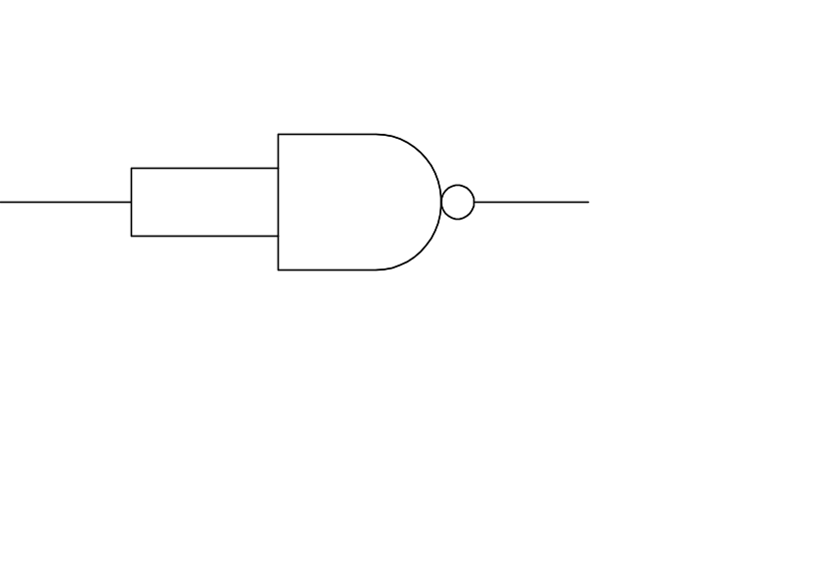
Redundancy Removal
Multiple redundancies can not be removed simultaneously
s-a-1
a
G1
b
s-a-1

Slide 16
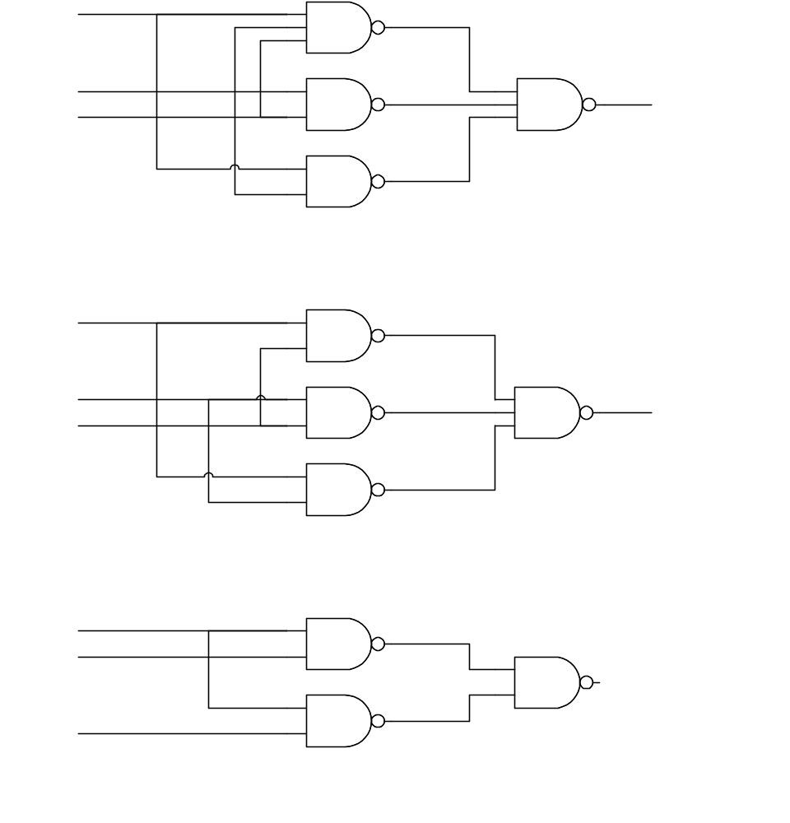
Redundancy Removal
The result of redundancy removal depends on the order in which redundancies are removed
a
G1
d
s-a-0
g
b
G2
e
G4
c
f
G3
Initial Circuit
a
G1
d
b
s-a-1
g
c
G2
e
G4
f
G3
After the removal of s-a-0 redundancy
a
d
c
G1
g
f
G4
b
G3
After the removal of the remaining redundancy

Slide 17
Desirable Property of Redundancy Removal
Increase the testability
Reduce area
Improve the performance by reducing the capacitive loads and the number of series transistors

Slide 18
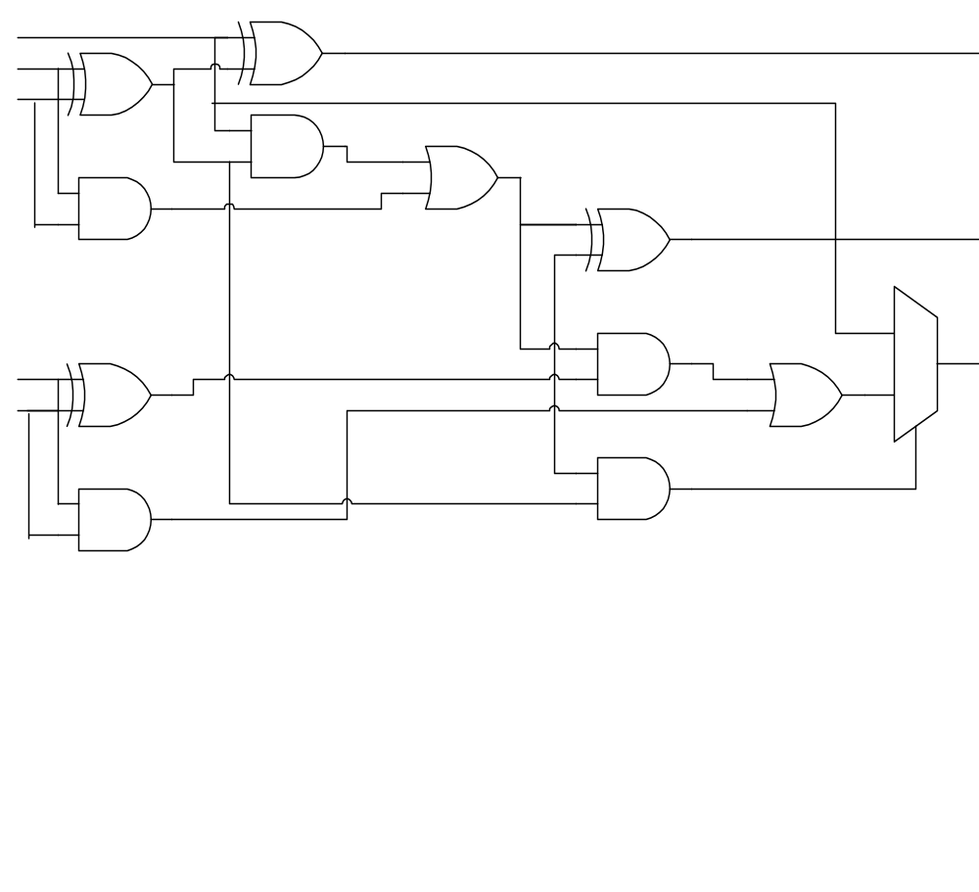
Counter-example
c0
G5
s0
a0
G1
b0
G6
G7
G2
G8
s1
G9
1
c2
a1
G3
G11
0
b1
G4
G10
s-a-0
A 2-bit carry-skip adder
S-a-0 fault on the control input of the MUX is untestable
Redundancy removal transforms a carry-skip adder to a ripple carry adder

Slide 19
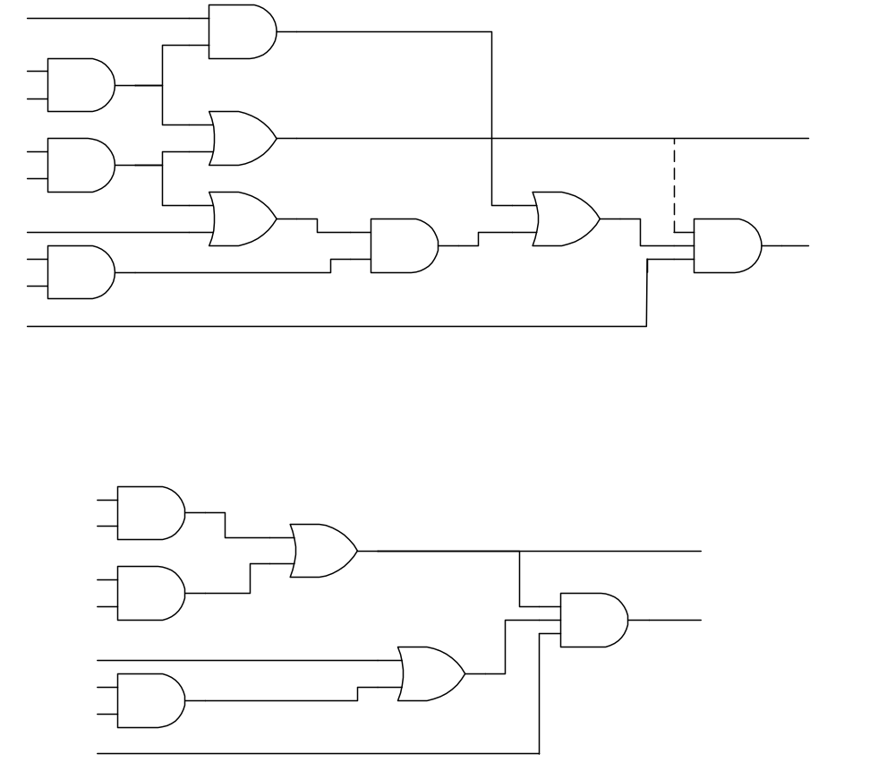
Logic Optimization by Redundancy Addition & Removal
c
g₄
b
g₁
redundant
d
g₅
o₁
e
g₂
redundant
c
g₆
g₈
d
g₇
g₉
o₂
a
g₃
b
f
b
g₁
d
g₅
o₁
e
g₂
g₉
o₂
c
c
g₈
a
g₃
b
f
Adding connection g₅ g₉
Connections g₁ g₄ and g₆ g₇ become redundant

Slide 20
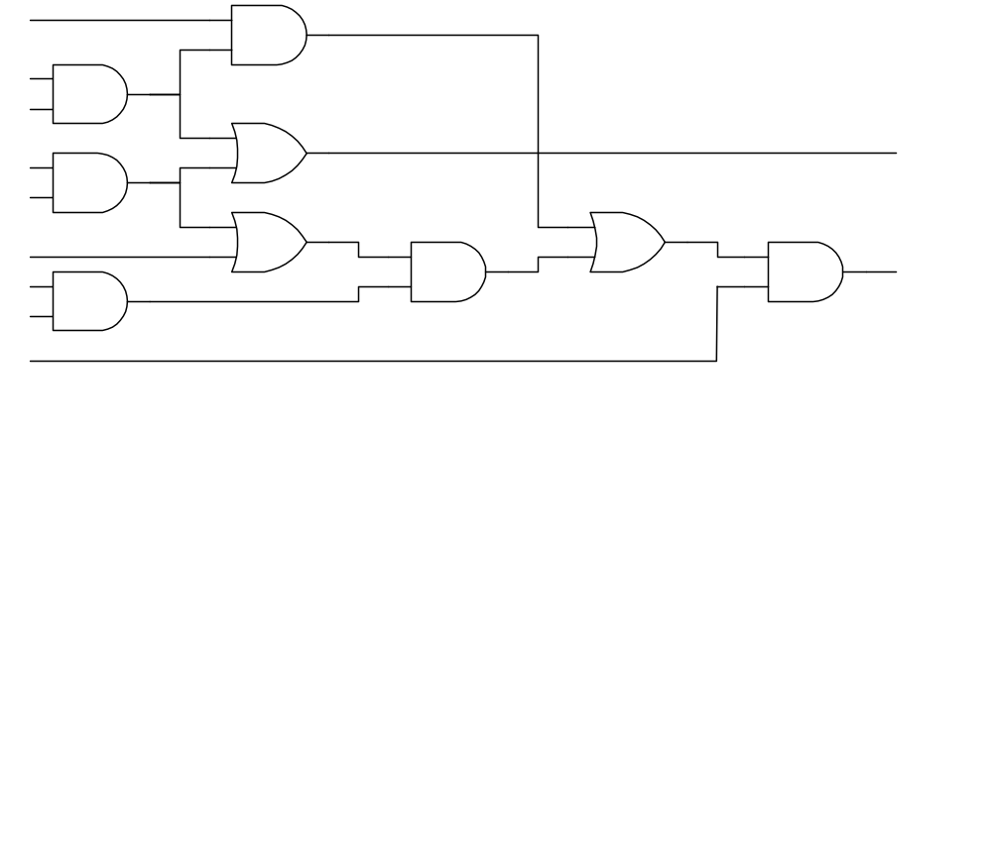
Definition
c
g₄
b
g₁
d
g₅
o₁
e
g₂
c
g₆
g₈
d
g₇
g₉
o₂
a
g₃
b
f
Absolute dominator (dominator) of a wire W: the set of gates G such that all paths from wire W to any primary output have to pass through all gates in G
Ex : dominators of g₁ g₄ : g₄, g₈, g₉

Slide 21
Definition
c
g₄
b
g₁
d
g₅
o₁
e
g₂
c
g₆
g₈
d
g₇
g₉
o₂
a
g₃
b
f
Side inputs of a dominator must be assigned to the gate’s non-controlling value in order to generate a test
Ex : To test g₁ g₄, s-a-1,
c = 1, g₇ = 0, f = 1

Slide 22
Mandatory Assignments
The value assignments required for a test to exist and they must be satisfied by any test vector
Use implication to compute MA
To compute entire set of MA is NP-complete
Derive SMA (Set of Mandatory Assignment) from dominators

Slide 23
Single Alternative Wire
Step1 : Calculate Mandatory Assignment for target faults
Step2 : Identify a set of candidate connec- tions to be added. Each addition will make the target fault untestable (redundant)
Step3 : Check whether a candidate is redundant
Step1 and Step3 can be performed by impli-cation and checking of the consistency of the SMA

Slide 24
Step 2 : Adding Connection
g_{s}= val
g₁g₂
g_{d}
target wire
(a) the original circuit
Type a
Type b
g_{s} = 0
g_{s} = 1
g₁
g_{d}
g₁
g_{d}
g₂
g₂
(b) two types of transformations
  The gate g_{d} is a dominator. The gate g₁ is in the fault propagating paths
  The gate g₂ is a side input. The gate g_{s} has a mandatory value, val, for the target fault.
g_{s} is not in the transitive fan-out of target wire

Slide 25
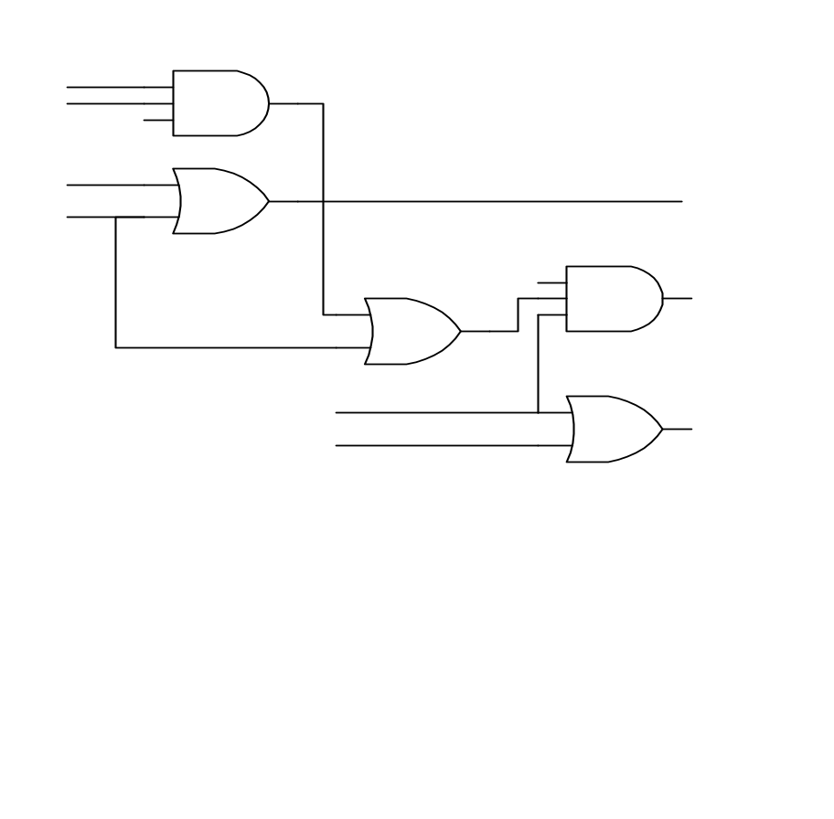
Example
a
g₂
b
c
g₁
o₁
d
g₃
g₅
o₂
e
g₄
o₃
f
a
g₂
b
c
g₁
o₁
d
g₃
g₅
o₂
e
g₄
o₃
f

Slide 26
False Path Identification

Slide 27
Static Delay Analysis
1
1
3
g h
3
2
c d e f
arrival time : from input to output
required time : from output to input
slack = required time - arrival time

Slide 28
Timing Analysis Problems
We want to determine the true critical paths of a circuit in order to:
  To determine the minimum cycle time that the circuit will function
  To identify critical paths for performance optimization – don’t want to try to optimize the wrong (non-critical) paths
Implications:
  Don’t want false paths (produced by static delay analysis)

Slide 29
False Paths
Static analysis is fast but leads to false paths
Path of length 400 is never “exercised”
Approaches:
  1. Mark orthogonal pairs
  May be wrong, can’t find all possibilities
  2. Throw out non-sensitizable (false) paths
Circuit delay = Length of longest path ?
  Not a good enough bound (too pessimistic)
Circuit delay = Time of last output change
=> Functional timing analysis for false paths
u
x
fj
200
MUX
200
MUX
1
0
fi
1
0
v
y
100
100
s

Slide 30
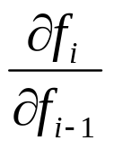
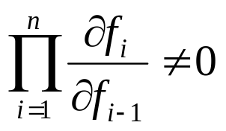
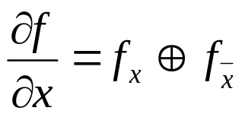
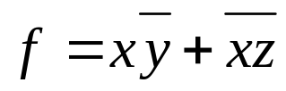
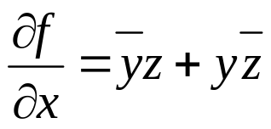
First Attempt: Boolean Difference
Check for “static false path”:
Path P = {f0, f1, f2, … , fn}
gives conditions under which node
fi is “sensitive” to node fi-1
=> Output of P is sensitive to f0 if
Recall Boolean difference:
Example:
fi-1
fi
fi+1

Slide 31
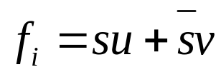
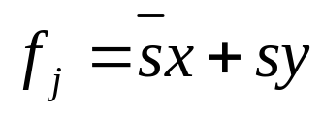
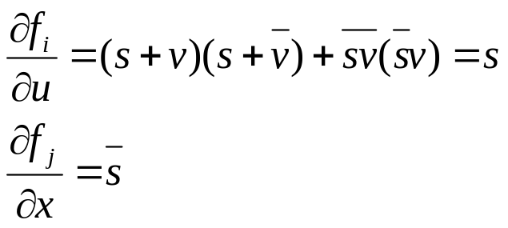
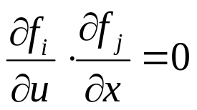
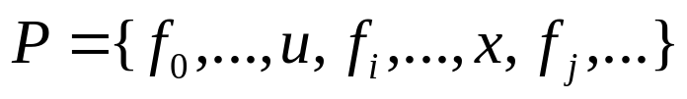
Example: Static False Path
u
x
fj
and
Hence,
Thus (by previous condition) any path
is not “statically sensitizable” and is “false”
200
MUX
200
MUX
1
0
fi
1
0
v
y
100
100
s

Slide 32
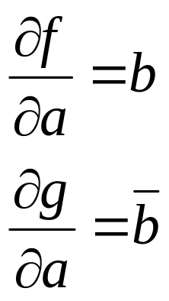
Definitions
Given a simple gate (i.e. AND, OR, NAND, NOR), a controlling value on an input determines the output of the gate independent of the other inputs
Given a simple gate (i.e. AND, OR, NAND, NOR), a non-controlling value on an input cannot determine the output of the gate independent of the other inputs
Example: 0 is a controlling value for AND gate. 1 is non-controlling value for AND gate
Note: Controlling / non-controlling value is merely a specialization of the Boolean difference to simple gates
a
b
f
a
b
g

Slide 33
Static Sensitization
Simple Gates:
Let path P = {f0, f1, …, fi}
A side-input to a gate fi along P is any input other than fi-1
An event is a transition from 0 to 1 or 1 to 0
Path P is statically sensitizable if there exists a primary input vector under which every side-input is set to a non-controlling value
A path is a “statically false path” if it is not statically sensitizable (see previous example)

Slide 34
Static Sensitization and False Paths
Static sensitization is wrong!
Paths shown in bold are not statically sensitizable, but delay of circuit is 3
d
a
1
b
e
g
1
c
1
1
f
a
b
c
d
e
f
g
constant 0
t= 0 1 2 3

Slide 35
Why Static Sensitization Fails
Static sensitization fails because it considers only the final value on each side-input. It does not consider values on side-inputs at the moment the event propagates from fi-1 through node fi
For example, in previous circuit when determining static sensitization of path {b, e, f, g} we assume side-input a of gate e is at final non-controlling value of 1. This is not necessary for the path to be sensitizable

Slide 36
Second Attempt:Dynamic Sensitizable Path
Given a path P = s0-g0-s1-……gk-sk in a circuit C. Path P is a dynamic sensitizable path if and only if there is at least one input vector such that for all signals si,
(1) si is the earliest controlling input of gate gi
(2) si is he latest non-controlling input of gate gi and the side inputs of gate gi are non-controlling inputs.

Slide 37
Second Attempt:Dynamic Sensitizable Path
(floating-mode)
Controlled value
0
early
0
Earliest-arriving controlling value determines the output stable time
late
0
Non-controlled value
early
1
1
late
1
Checking the falsity of every path explicitly is too expensive

Slide 38
False Path Analysis
State-of-the-art approach:
  D = topological longest path delay
  Is there an input vector under which an output gets stable only after or at t =D? (*)
    No: Decrease D and try it again
    Yes: The delay is D. Done
(*) is a SAT problem

Slide 39
Algorithm
Early-arrive-signals (si, *) = {sj | sj is an input signal to gate gi and Max-arrive-time(sj) < MinPD(si, P, *)}
Late-arrrive-signals (si, *) = {sj | sj is an input signal to gate gi and Min-arrive-time (sj) > MaxPD (si, P, *)}
Algorithm false_path_checking (P, false_path)
let P be the path to be checked and
P=s0, g0, s1, g1, …,si, gi, …, sk
where s0 and sk are a primary input and a primary output respectively
let Q be the event Queue and the format of event is (si, val),
where val is the logic value assigned to signal si
begin {The event generating phase}
Initialize Q
for each si alogn the path P do
begin
for each sj ∈ Early-arrive-signals(si, *) do
begin
enqueue(sj, val = non-control value of gate gi) into Q
end
if Late-arrive-signals(si, *) ≠φ then
begin
enqueue(si, val=control value of gate gi) into Q
end
end

